Slide 1

Aawaz
Rajasthan Police Hackathon - 1.0
Voice to Every Individual
POLICE FEEDBACK SYSTEM
TEAM JANKALYAN –
Girish Nikam
Prathamesh Thakare
Laxmipuja Biradar
Piyusha Patil

Slide 2
Intro video
Video Link

Slide 3
Aawaz : POLICE FEEDBACK SYSTEM
Introduction
Objective
Getting valuable feedback on police operations has been a persistent challenge due to outdated methods and privacy concerns.
Streamlining feedback through a user-friendly chatbot to encourage community participation.
This comprehensive platform “Aawaz” employs a user-centric approach, ensuring secure registration processes, controlled police station registration, dedicated dashboards
Enabling direct feedback to specific police stations, enhancing local issue resolution.
The platform incorporates an innovative feedback system facilitated by a chatbot. Users can seamlessly submit their experiences through chatbot interactions making it user-friendly.
Providing clear insights into community sentiments through intuitive dashboards.

Slide 4
Flow of Aawaz
Aawaz : POLICE FEEDBACK SYSTEM
Victim is added to the Aawaz Platform by police station
Victim gets the feedback link where he/she can submit the feedback
Victim feedback is successfully submitted to particular police profile
SuperAdmin takes the action accordingly
SuperAdmin can see the report of police station

Slide 5
Types of Users -
Aawaz : POLICE FEEDBACK SYSTEM
CITIZEN
Citizen
Allows them to submit feedback on police operations
POLICE STATION
Police Station
Sends unique feedback links to citizens and confirming whether user has submitted the feedback
ADMIN
Admin
Provides administrative control over resgistered police stations on the app ensuring managing and authorization

Slide 6
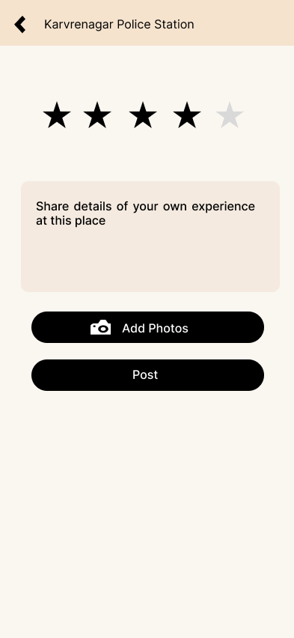
Citizen Module
Aawaz : POLICE FEEDBACK SYSTEM
Manual Feedback

Slide 7
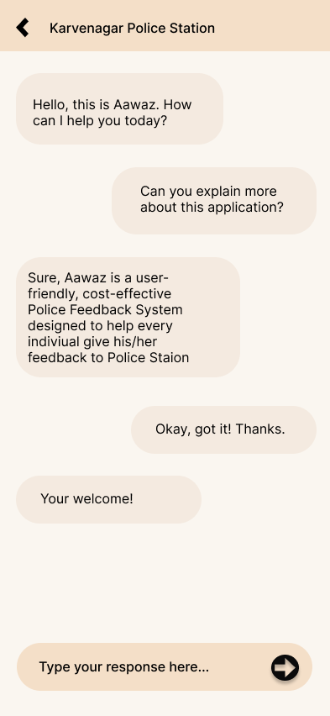
Citizen Module
Using ChatBot

Slide 8
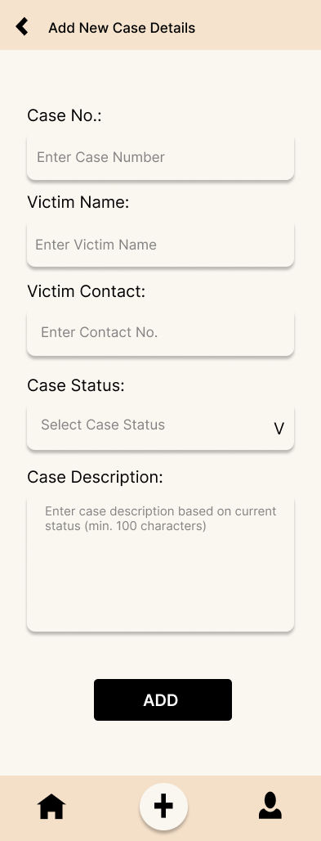
Police Station Module
Add Case Details

Slide 9
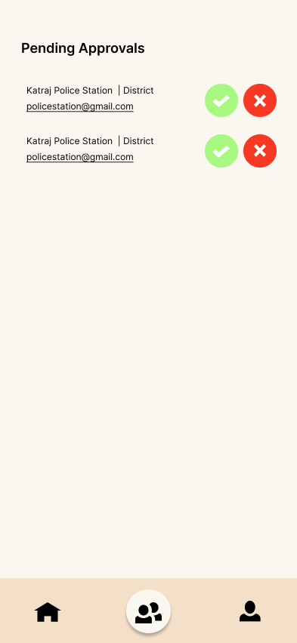
Super Admin Module
It is upto Admin weather to accept the approval of police station on not

Slide 10
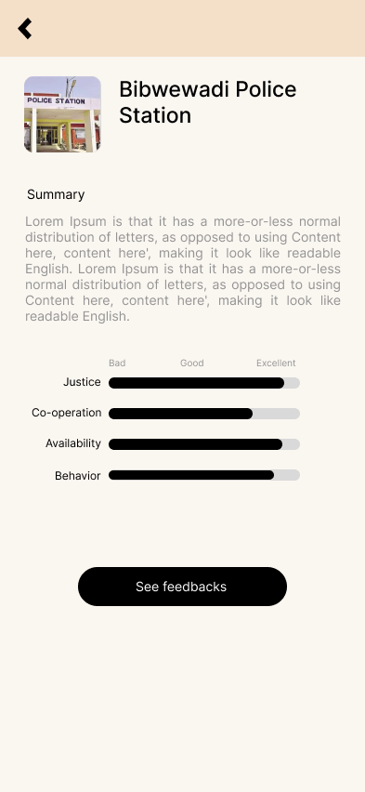
Super Admin Module
-A summary of all the comments till date is received using Google’s LLM model
-Using Sentiment Analysis we categorize the feedback as Positive or Negative

Slide 11
What makes our “Aawaz” unique than other models
Aawaz : POLICE FEEDBACK SYSTEM
04
Interactive Chatbot
MultiLingual
03
02
Sentiment Analysis and Summarization of feedback
For disabled ppl
Text to Speech Integration
01

Slide 12
Implications
Aawaz : POLICE FEEDBACK SYSTEM
First
Second
Third
Enhanced Accountability
Improved Community Relations:
Healthy Competition

